Slide 1
Cybersecurity

Slide 2
Introduction
In this presentation, we'll explore the topic of Cybersecurity through a bird’s eye view.

Slide 3
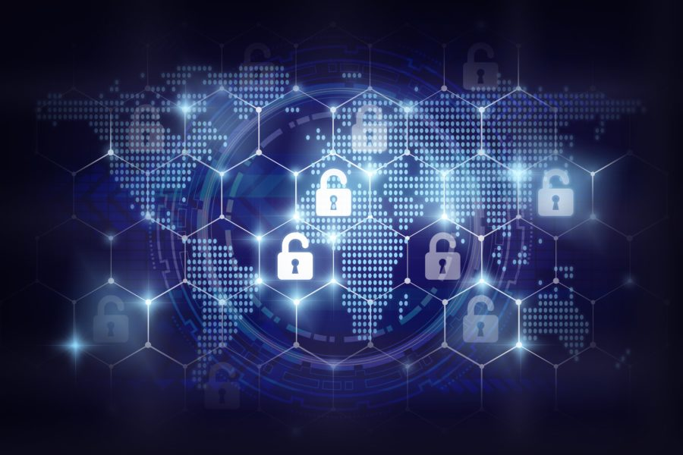
What is Cybersecurity?
The practice of protecting systems, networks, programs, devices, and data from attacks
Safeguarding the confidentiality, integrity, and availability of information

Slide 4
Malware & Its Variants
Malware: Malicious software designed to harm or exploit devices
Ransomware: A type of malware that locks data until a ransom is paid
Viruses: Malware that can replicate and spread to other devices
Spyware: Secretly monitors and collects user information

Slide 5
Cybersecurity Threats
Malware, ransomware, viruses, spyware
Phishing emails, social engineering
Denial of service attacks, data breaches
Insider threats, unauthorized access
Real-time heatmap by Kaspersky (mostly DoS)

Slide 6
Famous Malware
Stuxnet: Initially discovered in 2010, Stuxnet is a malicious worm believed to have been developed by the U.S. and Israel. It targeted Iranian nuclear facilities, causing significant damage to the nuclear program.
Zeus (or Zbot): A Trojan horse malware package that primarily targets banking information. First identified in 2007, Zeus has been responsible for stealing vast amounts of personal and financial data.
Cryptojacking: refers to the unauthorized use of someone else's computer or device to mine cryptocurrency. This can be done by either tricking a person into clicking on a malicious link that loads cryptomining code on the computer or by infecting a website or online ad with JavaScript code that auto-executes once loaded in the victim's browser.

Slide 7
Famous Ransomware
WannaCry (or WannaCrypt): Erupted in May 2017, affecting more than 230,000 computers across 150 countries in just one day. It exploited a vulnerability in Microsoft Windows, known as the EternalBlue exploit. The ransomware demanded payment in Bitcoin and caused significant disruptions, especially in the healthcare sector, with the NHS in the UK being notably affected.
NotPetya: Initially mistaken for a variant of the Petya ransomware, NotPetya emerged in June 2017, primarily targeting Ukrainian businesses but rapidly spreading worldwide. It's notably destructive and was later assessed as a state-sponsored cyber weapon, disguised as ransomware. Major global companies, including Maersk, Merck, and FedEx, reported significant disruptions due to the NotPetya attack.
Ryuk: Identified around August 2018, Ryuk targeted large organizations with high ransom demands, often in the range of hundreds of thousands to millions of dollars. It's known for its "big game hunting" approach, focusing on targets that are likely to pay large ransoms. Ryuk has been associated with multiple high-profile incidents, including several attacks on U.S. cities and hospitals.

Slide 8
Famous Viruses
ILOVEYOU: Originating from the Philippines in 2000, this computer worm spread via email and affected millions of computers. It overwrote random types of files, causing significant data loss.
Slammer (or SQL Slammer): A fast-spreading worm that caused a massive internet slowdown in 2003. It primarily targeted Microsoft SQL servers.
Mydoom: Appearing first in 2004, it's one of the fastest-spreading email worms. It allowed attackers to access infected machines, leading to the creation of a massive botnet.

Slide 9
Famous Spyware
CoolWebSearch: Discovered in 2003, it's a browser hijacker that redirects web searches to advertisements. It also comes with various payloads, including keystroke logging.
Zango (formerly 180 Solutions): Adware that was notorious for its deceptive installation practices. Once installed, it displayed targeted ads to users based on their internet behavior.
Gator (or Claria): Adware that monitored users' browsing habits to serve targeted ads. It often came bundled with popular free software and was notorious for being difficult to remove.

Slide 10
Defense against malware
Regular Software Updates: Patch vulnerabilities by keeping all software current
Antivirus & Anti-malware: Use trusted solutions and schedule frequent scans
Firewall: Activate system or hardware firewalls for added protection
Email Caution: Avoid opening attachments/links from unfamiliar sources
Safe Downloads: Only get software/apps from official or reputable sources
Strong Passwords & 2FA: Use complex passwords and enable two-factor authentication
Regular Backups: Store data backups externally or on the cloud to counter ransomware threats
User Education: Train users on security best practices
Safe Browsing: Stick to HTTPS websites and avoid suspicious sites
VPN: Encrypt internet connections for added security

Slide 11
Phishing & Social Engineering
Phishing Emails: Deceptive emails that trick recipients into giving away sensitive information.
Social Engineering: Manipulating individuals into revealing confidential information.

Slide 12
Phishing Attack Example: Fake Bank Email
Subject: "Urgent: Verify Your Account!"
Sender: "support@banksecure247.com" (Note: Not the official bank domain)
Content: Claims unusual activity and urges immediate account verification.
Link: "Verify Now" - Redirects to a lookalike bank login page.
Red Flags:
Unexpected email.
Suspicious sender address.
Urgent action requested.
URL mismatch upon hovering over the link.
Gophish.com - Phishing attack simulator

Slide 13
Social Engineering Example: The Friendly IT Support
Approach: Phone call from "Company IT Support".
Introduction: "Hi, I'm Alex from IT. We're doing a security check."
Request: Asks for your login details to "verify" account security.
Urgency: Mentions potential data breaches, insisting on immediate action.
Red Flags:
Unscheduled call.
Requests sensitive information over the phone.
Creates a sense of panic.
No prior email notification about a security check.

Slide 14
Defense Against Phishing Attacks
Email Scrutiny: Check sender details and unexpected links.
URL Verification: Ensure links start with "https".
Activate 2FA: An extra layer of login security.
Use Anti-phishing Toolbars: Available in modern browsers.
Stay Updated: Regularly update browsers and security software.
Employ Email Filters: Screen out potential threats.
Educate Users: Awareness of phishing red flags.
Report & Act: Alert IT about suspicious emails.
Backup Regularly: Safeguard against ransom demands.
Stay Informed: Know the latest phishing techniques.

Slide 15
Attacks on Service and Data
Denial of Service Attacks: Overwhelm systems to make them unavailable.
Data Breaches: Unauthorized access leading to data exposure.

Slide 16
Famous DDos Attacks
Dyn (2016):
Affected sites: Twitter, Reddit, Netflix, and more.
Caused by the Mirai botnet.
Estimated devices involved: Over 100,000.
BBC (2015):
BBC's entire domain, including its on-demand television and radio player, was offline.
Attack peaked at over 600 Gbps.
GitHub (2018):
Largest-ever recorded DDoS attack at the time.
Attack peaked at 1.35 Tbps.
Lasted for about 20 minutes.

Slide 17
Famous Data Breaches
Equifax (2017):
Affected individuals: 147 million.
Exposed: Social Security numbers, birth dates, addresses.
Cost: Over $4 billion in total.
Yahoo (2013-2014):
Affected accounts: 3 billion (revealed in 2017).
Exposed: Names, email addresses, telephone numbers, dates of birth.
Yahoo's valuation was reduced by $350 million in its sale to Verizon.
Marriott International (2018):
Affected guests: 500 million.
Exposed: Passport numbers, credit card information, mailing addresses.
Resulted in a fine of £99 million by the UK's Information Commissioner's Office.

Slide 18
Threats from Within
Insider Threats: Malicious actions taken by employees or insiders.
Unauthorized Access: Accessing systems without permission, often for malicious intent.

Slide 19
Famous insider leaks
Edward Snowden (2013):
Organization: National Security Agency (NSA), USA.
Incident: Leaked thousands of classified documents to journalists.
Impact: Revealed global surveillance programs run by the NSA and its partners.
Morris Worm (1988):
Organization: Massachusetts Institute of Technology (MIT).
Incident: Robert Tappan Morris created and released the first worm on the internet, claiming it was an experiment.
Impact: Infected around 6,000 computers (10% of the internet back then) and caused significant disruptions.
Waymo vs. Uber (2017):
Organization: Waymo (formerly Google's self-driving car project).
Incident: Levandowski, a former Waymo employee, allegedly stole 14,000 technical files related to lidar technology before starting his own self-driving truck company, which was later acquired by Uber.
Impact: Led to a high-profile legal battle between Waymo and Uber. The case was settled with Uber agreeing not to use Waymo's confidential information in their products and to pay a financial settlement.

Slide 20
General security practices
Securing the infrastructure: firewalls, intrusion detection systems (IDS), antivirus software
Securing applications: access controls, input validation, multifactor authentication
Proper incident response systems
Data encryption, backup and recovery
Constant monitoring & testing
Security training, policies, audits
The last point is very important - more often than not, the weakest link in the system is a human!

Slide 21

Case study: Twitter 2020 hack
In July 2020, the Twitter accounts of high-profile figures including Barack Obama, Joe Biden, Jeff Bezos, and Elon Musk were hacked in a coordinate social engineering attack.
The attackers were able to gain access to an internal Twitter administrative tool and then used social engineering to trick Twitter employees into providing passwords to the tool
Specifically, the hackers called employees pretending to be IT staff and claimed to needing passwords to complete urgent maintenance
With the compromised employee credentials, the attackers were then able to tweet from any account
This exploit highlights how even strong security systems can be undermined by human error and susceptibility to social engineering attacks
Proper training for employees on phishing and authentication procedures could have prevented the breach that led to serious reputational damage for Twitter

Slide 22
Case study: Bitmart Exchange 2021 hack
The cryptocurrency exchange Bitmart lost around $200 million in user assets after their private keys were compromised.
The hackers gained access by phishing a Bitmart employee through a fake recruiter email
The employee entered their credentials which were then used to access Bitmart's hot wallet private keys
With the keys, hackers were able to transfer user funds to their own crypto wallets and obscure the transactions
This demonstrates how social engineering and human error enabled criminals to bypass technological security measures and steal cryptocurrency assets
In this case however, besides the human error there was also the issue of an improper key management system

Slide 23
Investing in Cybersecurity
Cyber threats are growing - The number and complexity of cyber attacks continues to increase each year. Investing in security helps mitigate emerging threats.
Avoid costs of breaches: A breach can lead to fines, legal liability, business disruption, and loss of customer trust. Proactive security reduces breach costs that can reach millions of dollars.
Gain competitive advantage: Security fosters customer trust and demonstrates you value data integrity. This can differentiate you.
Adhere to regulations: New regulations require heightened cybersecurity measures. Investing ensures compliance.
Train personnel: Your people are critical in combating phishing and social engineering. Training eliminates weak links.
Update defenses: New attack methods require updating firewalls, malware protection, authentication protocols, and detection tools.
Hire specialists: Dedicated cybersecurity staff, like a CISO, provide expertise to implement robust defenses.
Assess vulnerabilities: Audits identify gaps so you can address weaknesses and improve readiness.

Slide 24
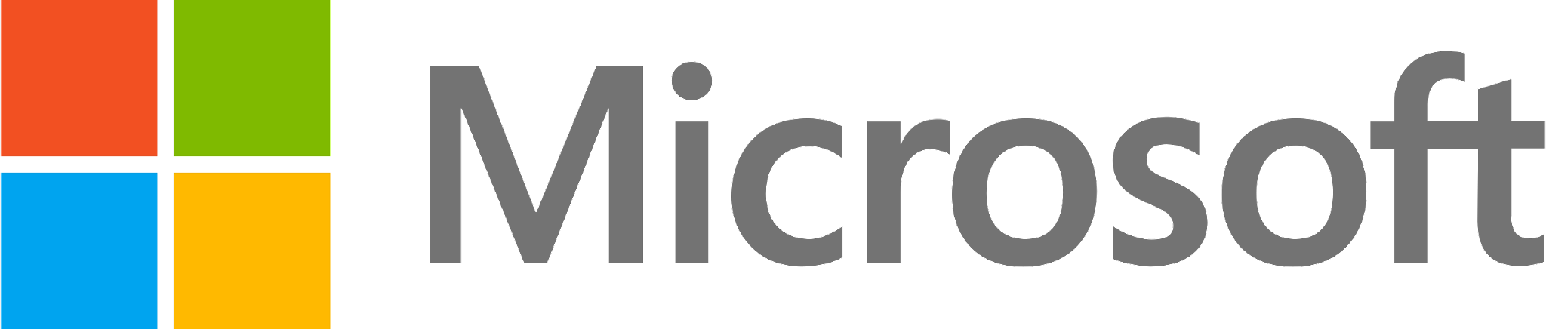
Case study: Microsoft’s CS investment
Microsoft underwent a massive cultural shift to prioritize security after major worms like Blaster and SQL Slammer caused worldwide outages in 2003.
They established a dedicated Trustworthy Computing team and trained all developers on secure coding
They also incorporated the Security Development Lifecycle to embed security across software development
These steps transformed Microsoft's security practices and led to more secure products

Slide 25

Case study: Target’s CS investment
After a 2013 breach exposed data for 70 million customers, Target invested heavily in cybersecurity.
They appointed a Chief Information Security Officer, doubled the security team, and implemented tools like endpoint detection
They also offered free credit monitoring to impacted customers
Their hands-on response to the crisis transformed security and restored customer trust

Slide 26
Thank you!
Q & A

